Slide 1
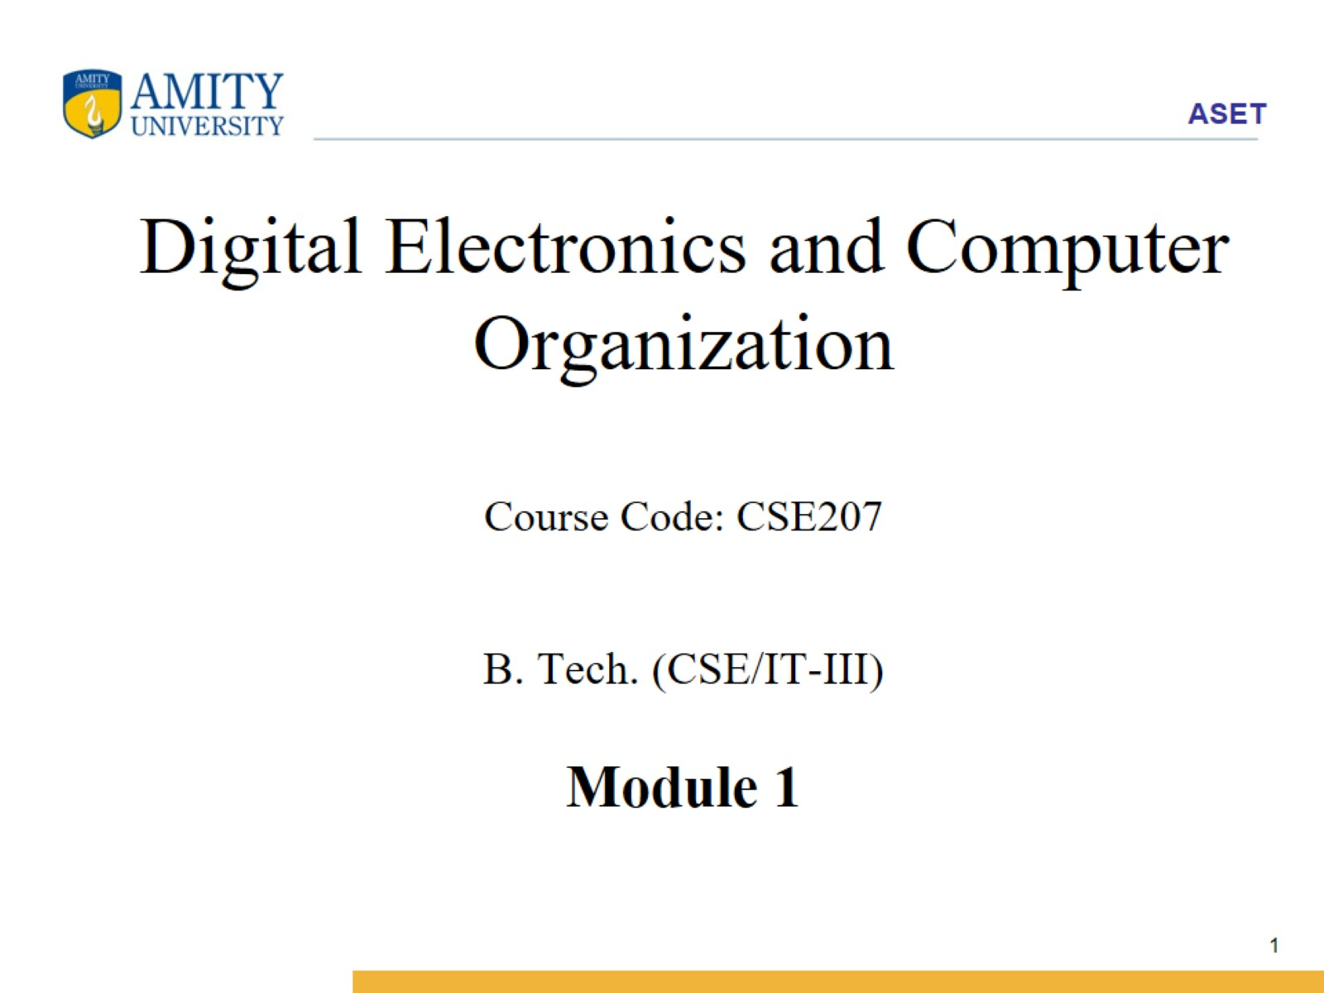
Digital Electronics and Computer Organization
Course Code: CSE207
B. Tech. (CSE/IT-III)
Module 1

Slide 2
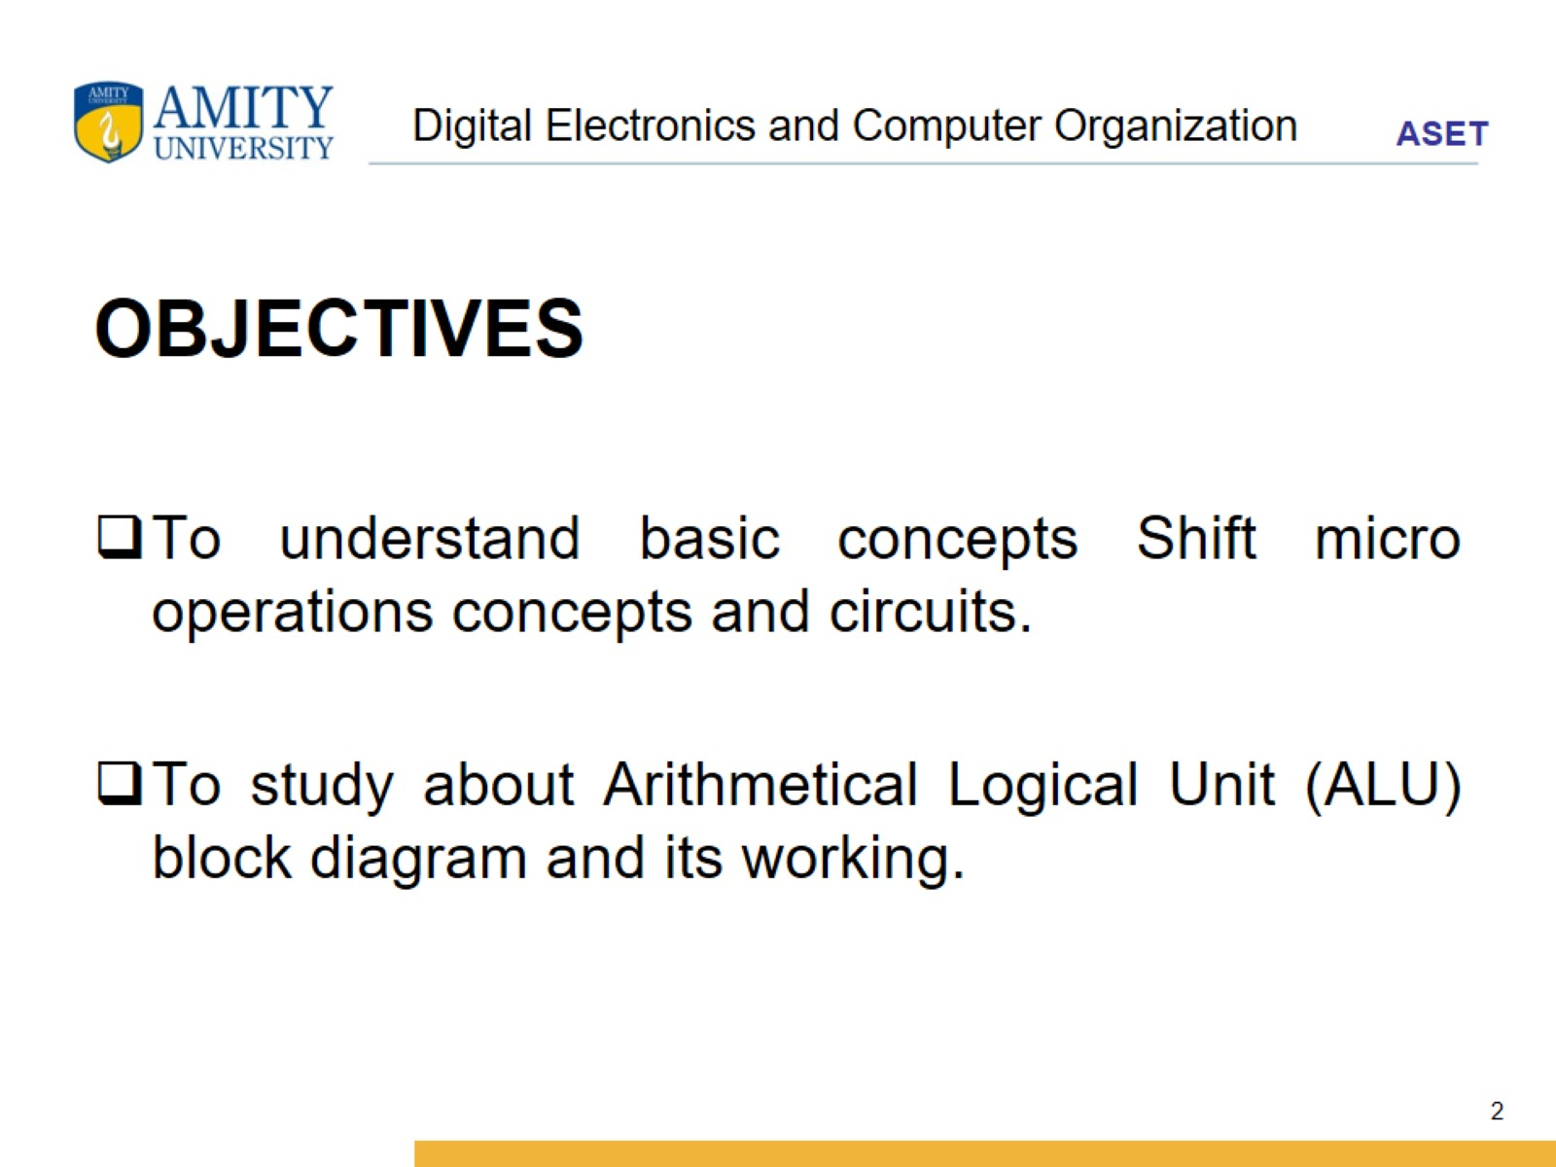
Digital Electronics and Computer Organization

Slide 3
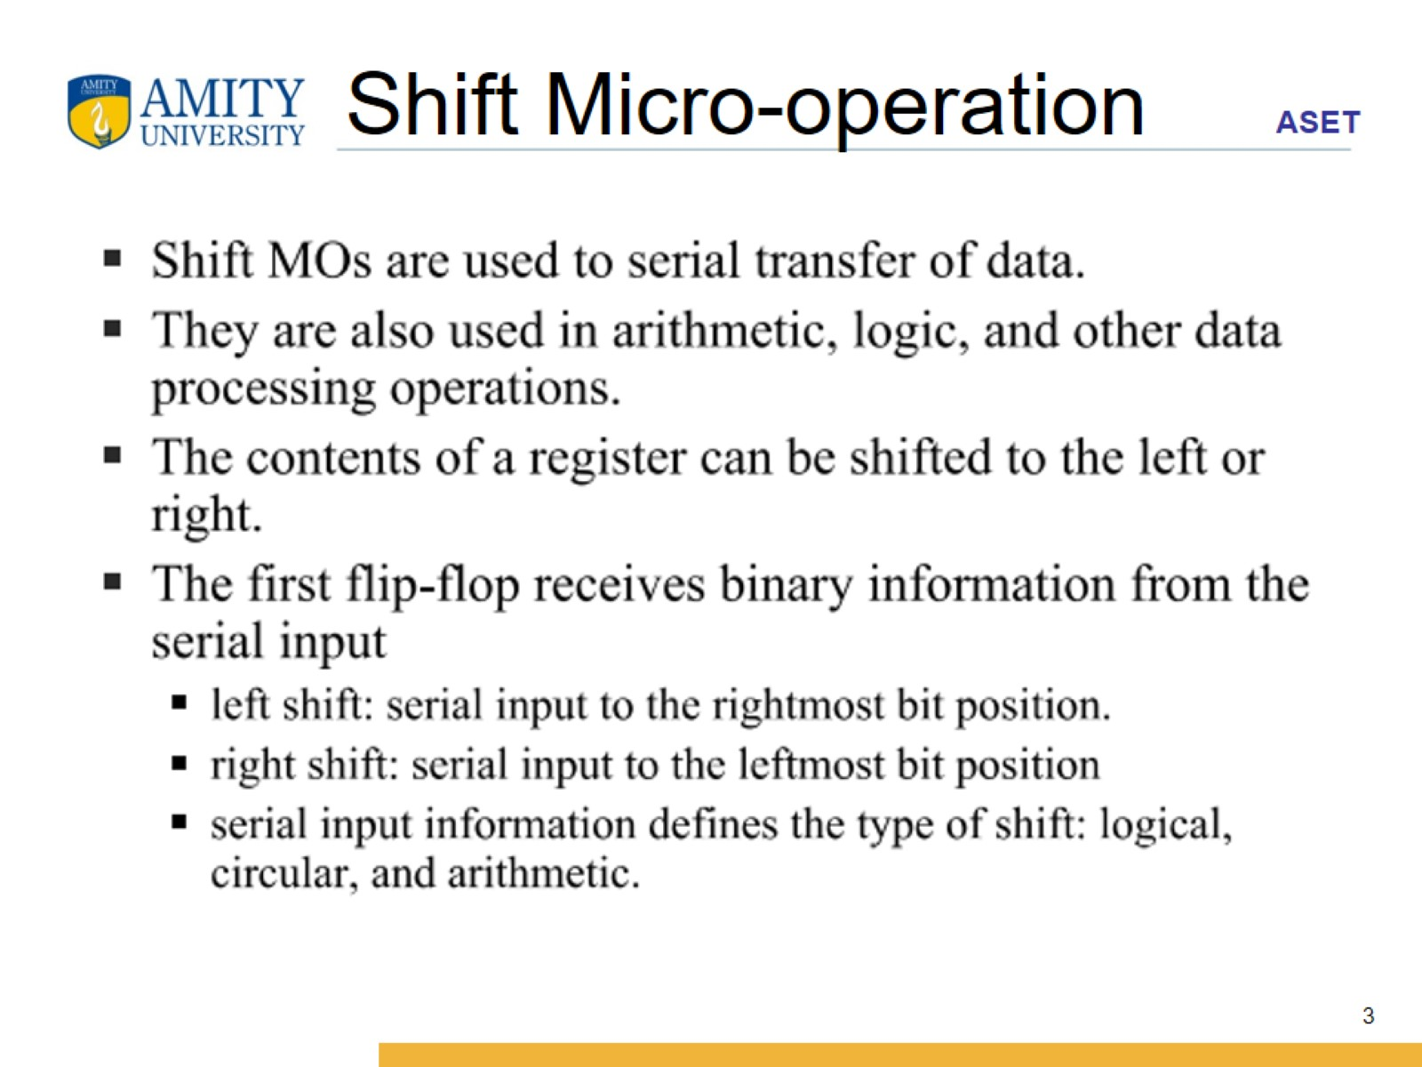
Shift Micro-operation

Slide 4
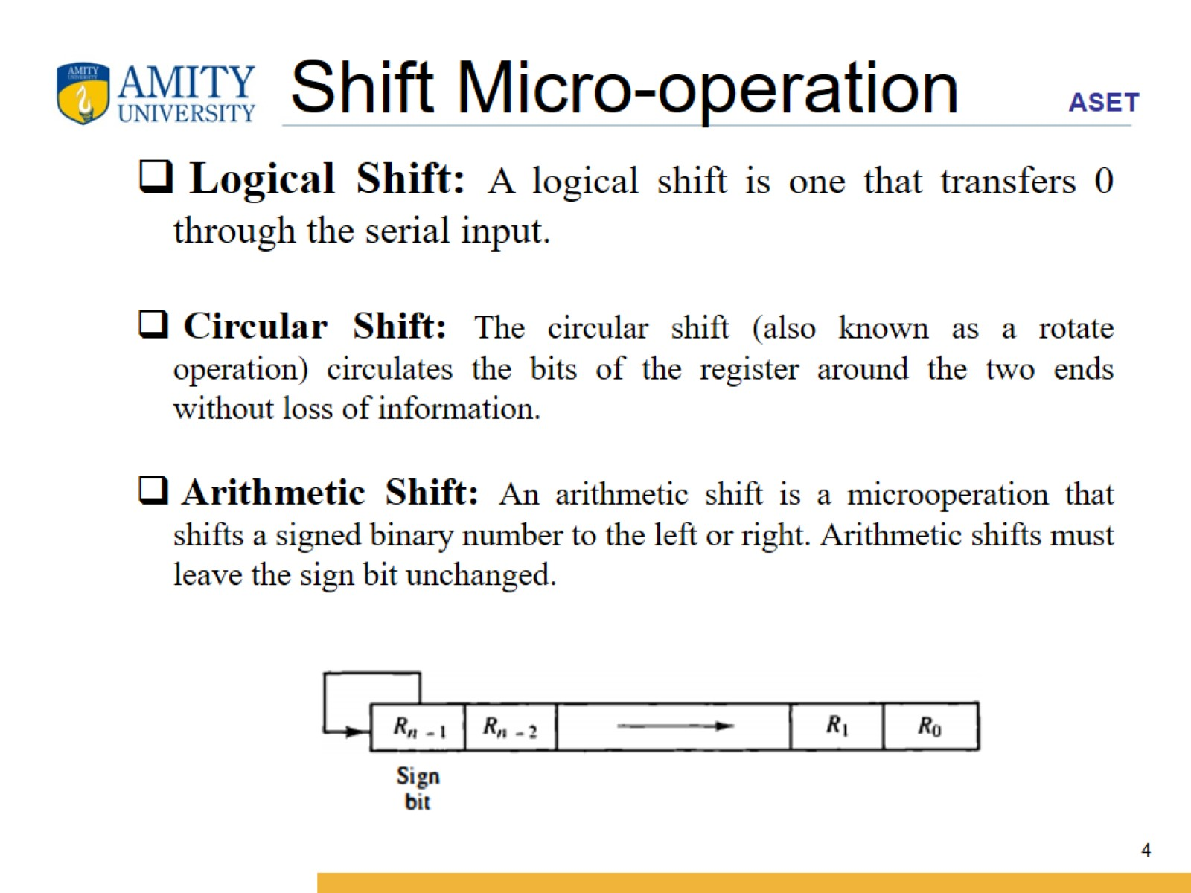
Shift Micro-operation

Slide 5
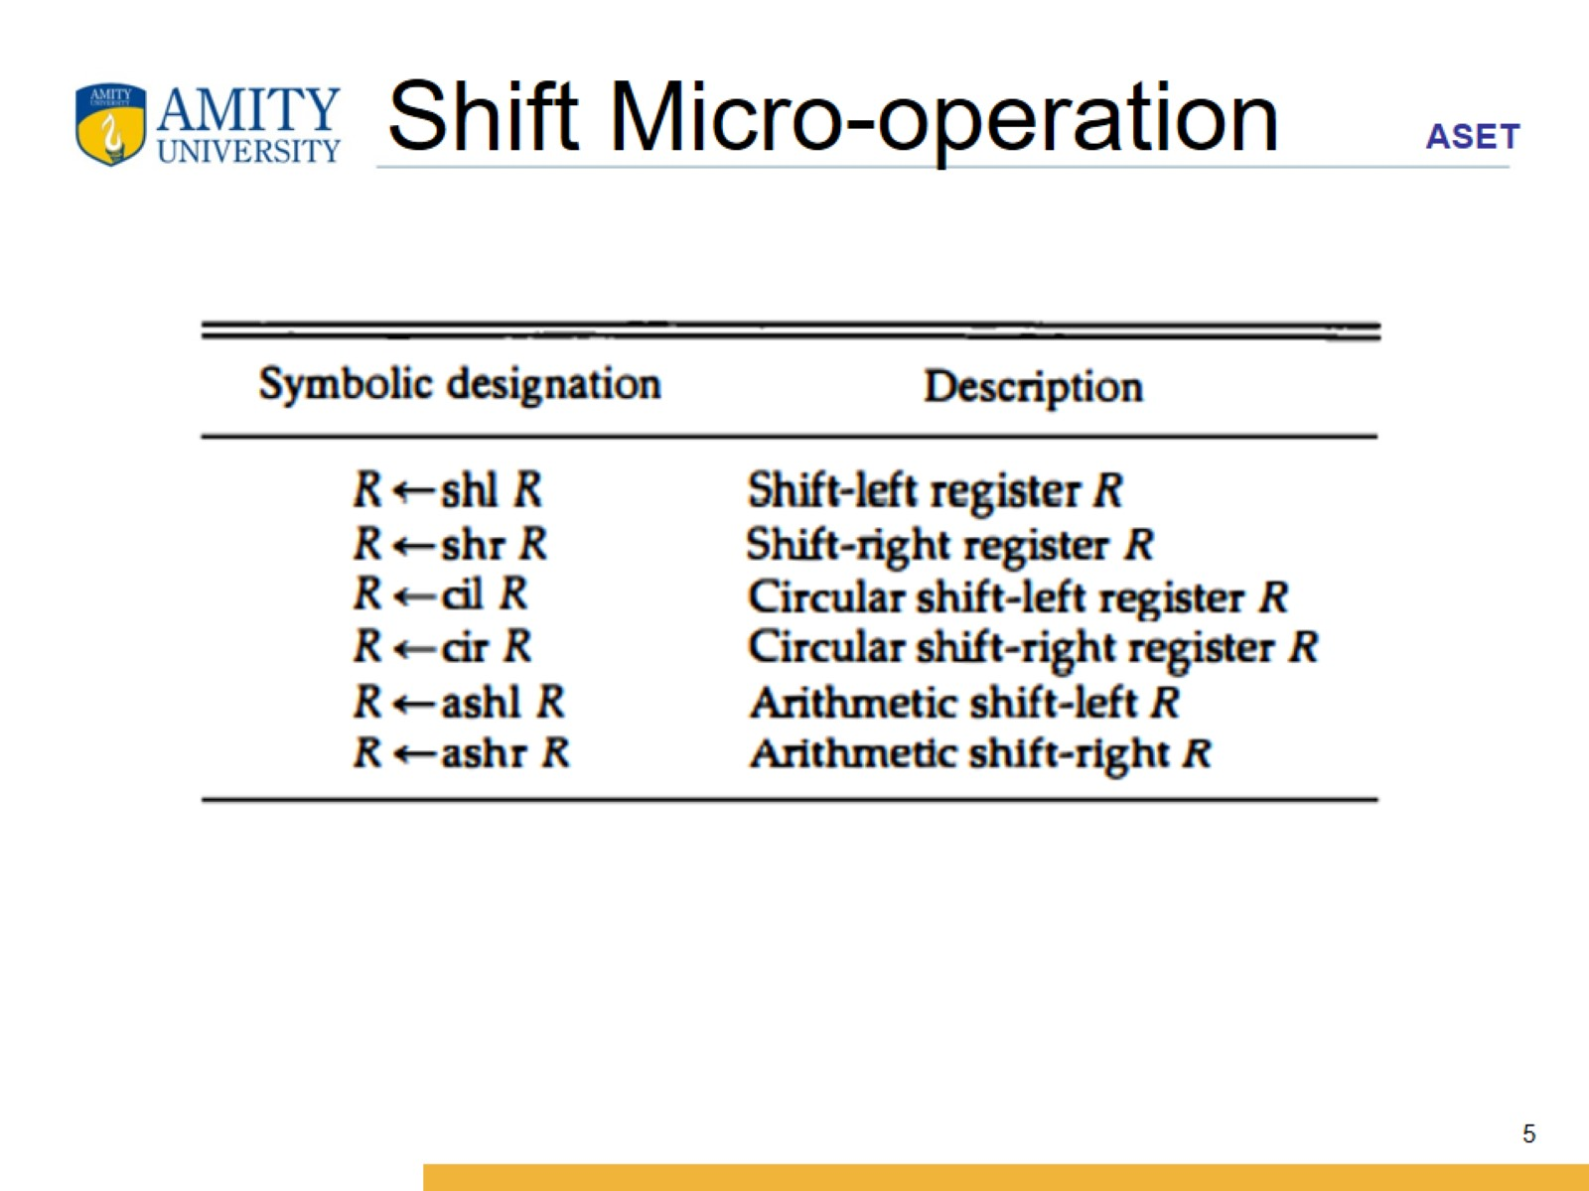
Shift Micro-operation

Slide 6
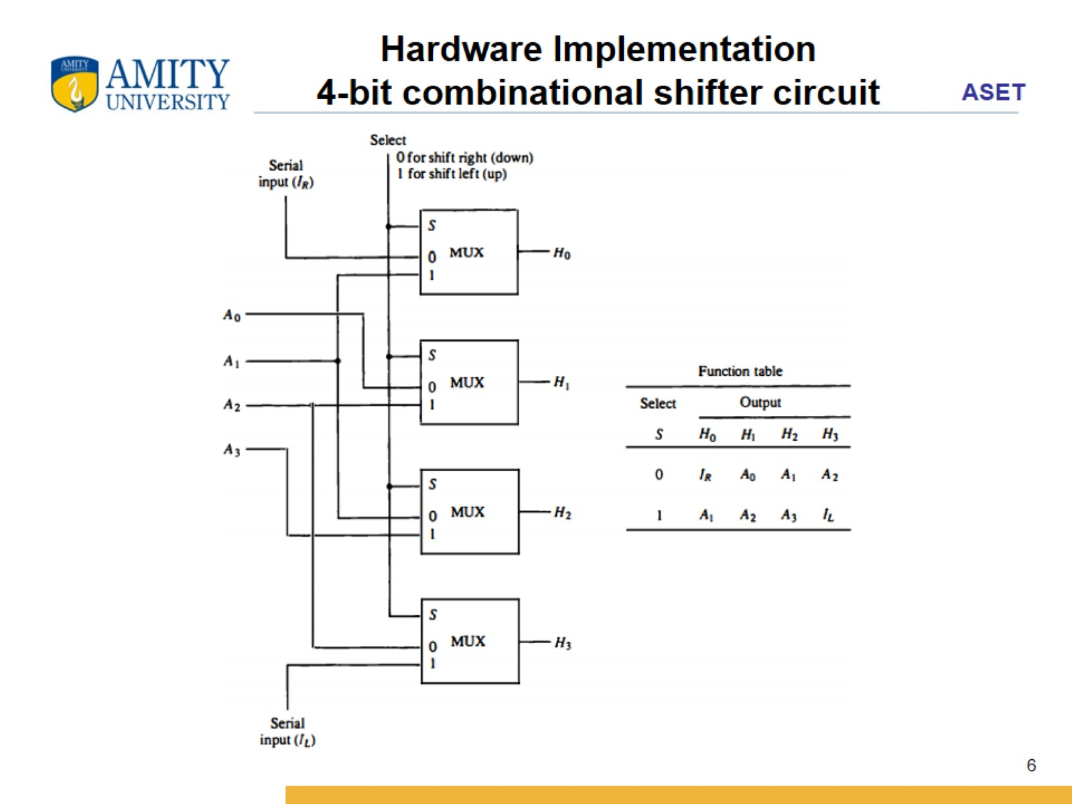
Hardware Implementation
4-bit combinational shifter circuit

Slide 7
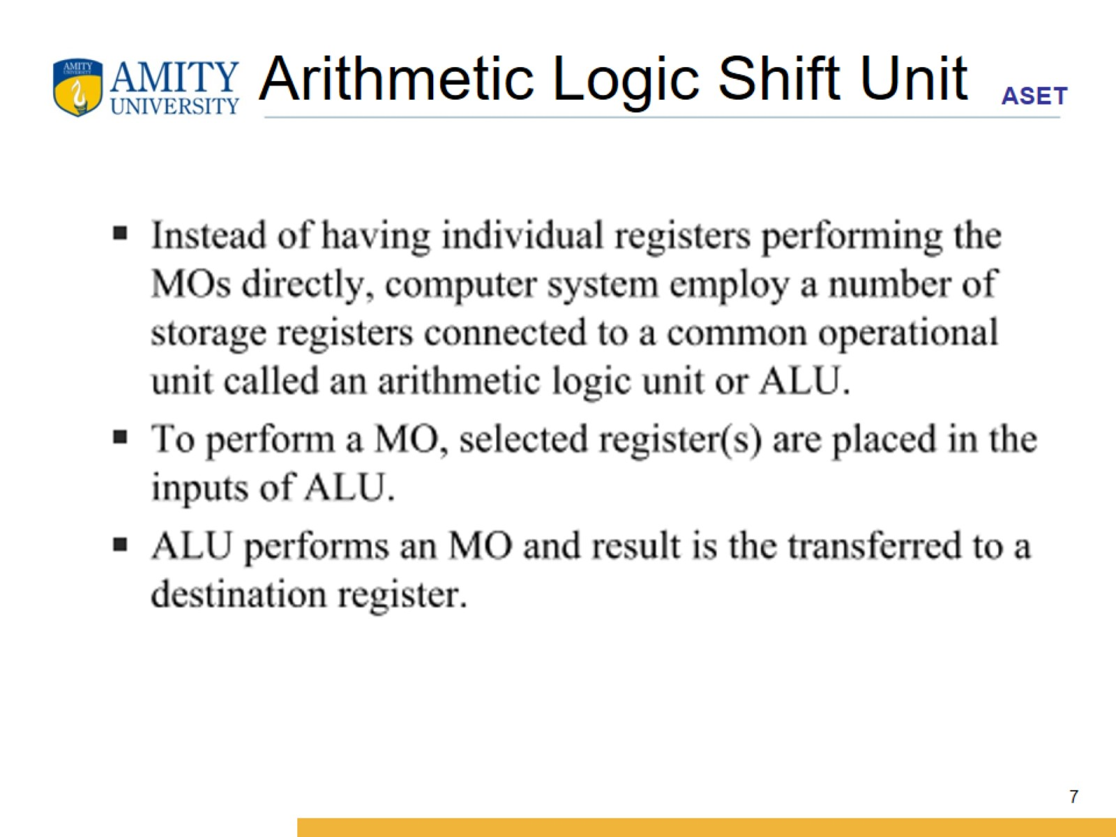
Arithmetic Logic Shift Unit

Slide 8
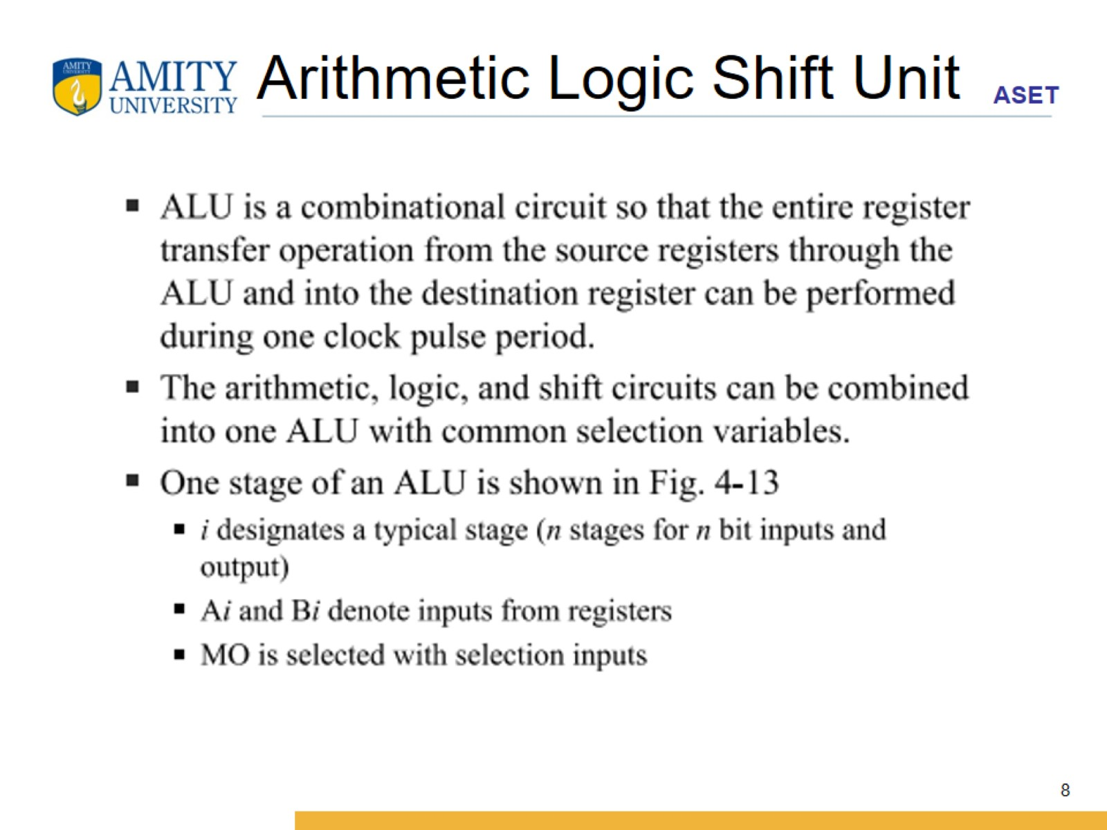
Arithmetic Logic Shift Unit

Slide 9
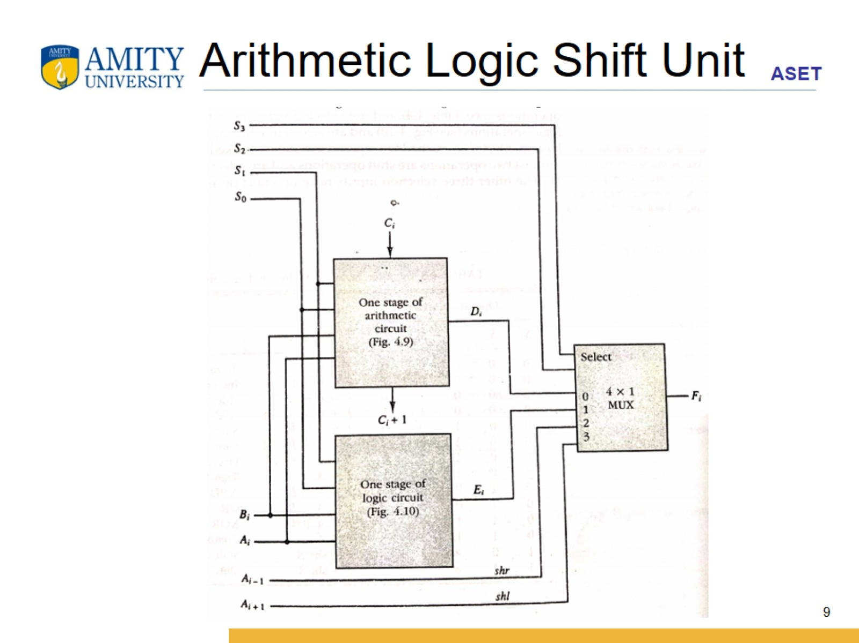
Arithmetic Logic Shift Unit

Slide 10
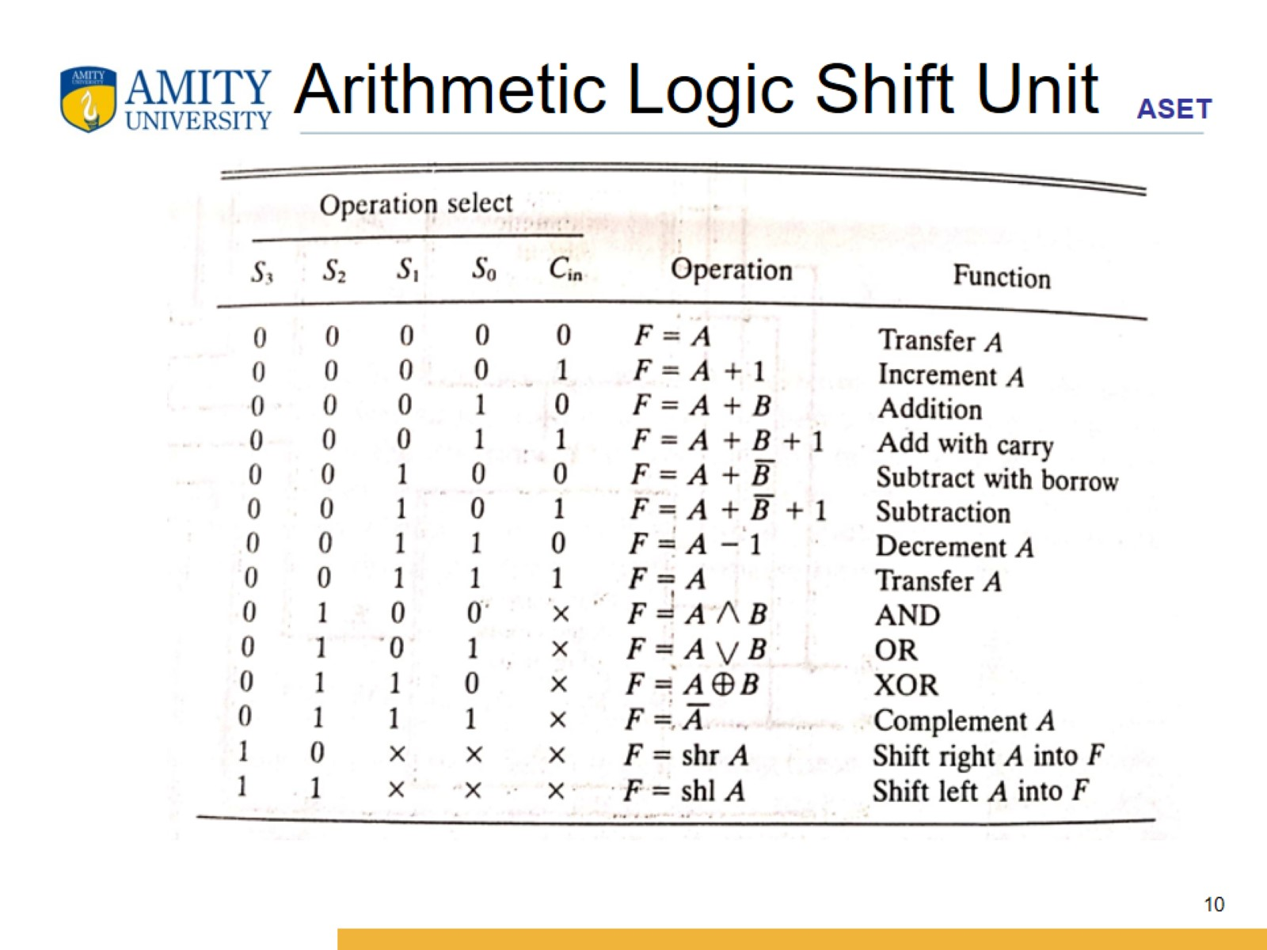
Arithmetic Logic Shift Unit

Slide 11
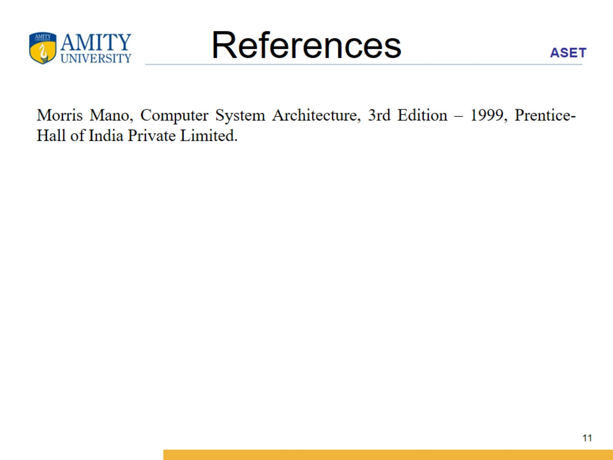
References

